Slide 1


Electric Vehicle Support Infrastructure
Estimating the Additional Electricity Generation required to Supply Electric Vehicles in the Future

Slide 2
Contents
Analysis of UK Road Traffic Data
Regression – Estimating Future Traffic
Research – Electric Vehicle Adoption
Recommendation - Appropriate Generation Technologies
References

Slide 3
Analysis of UK Road Traffic Data
Summarising Traffic Data sourced from UK Government Statistics; grouping data by Region and Vehicle Type per year
Annual Mileage calculated by multiplying link length with AADF of each vehicle type (and all motor vehicles) by 365 days (Department for Transport, 2019)
Annual Mileage for Major Roads calculated using above method; minor roads estimated by the following formula:
Annual Mileage (Minor Roads) = Annual Mileage (Minor Road Estimate*)
x Change in Road Length (Minor Road)
x Weight (Vehicle Type)
*Initial Minor Road Estimate for 2000 = 100 Billion Miles (Department for Transport, 2019)

Slide 4
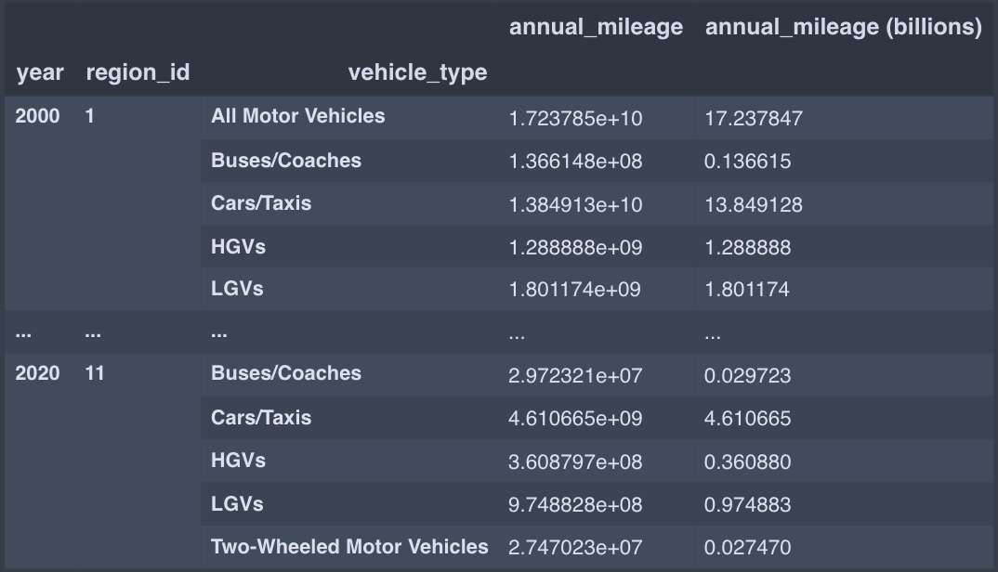
Annual Mileage (Major Roads) grouped by Region ID and Vehicle Type

Slide 5
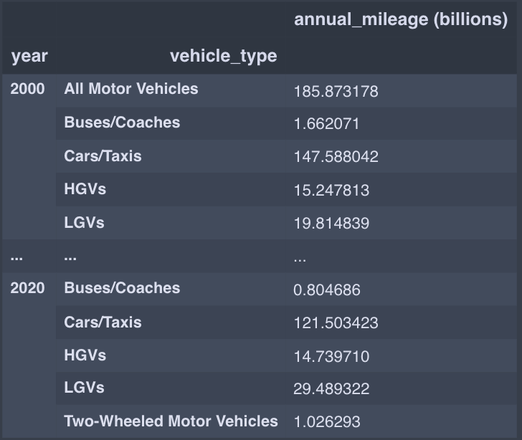
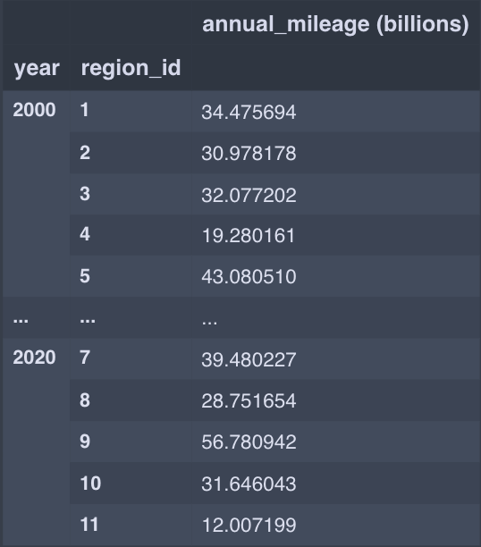
Annual Mileage of Major and Minor Roads Combined
By Vehicle Type: By Region ID:

Slide 6
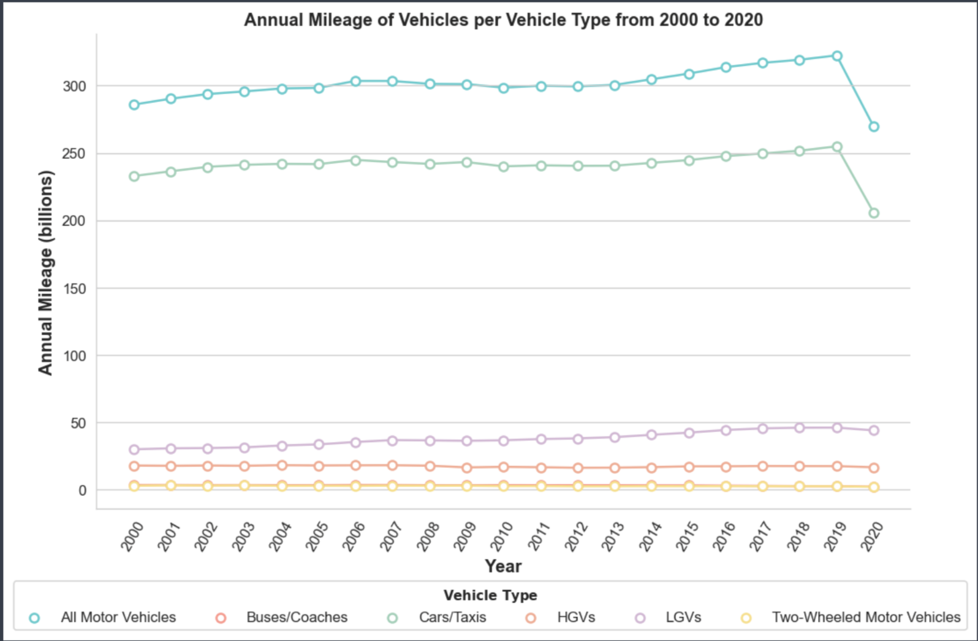
Analysis - Visualising Trends in Data

Slide 7
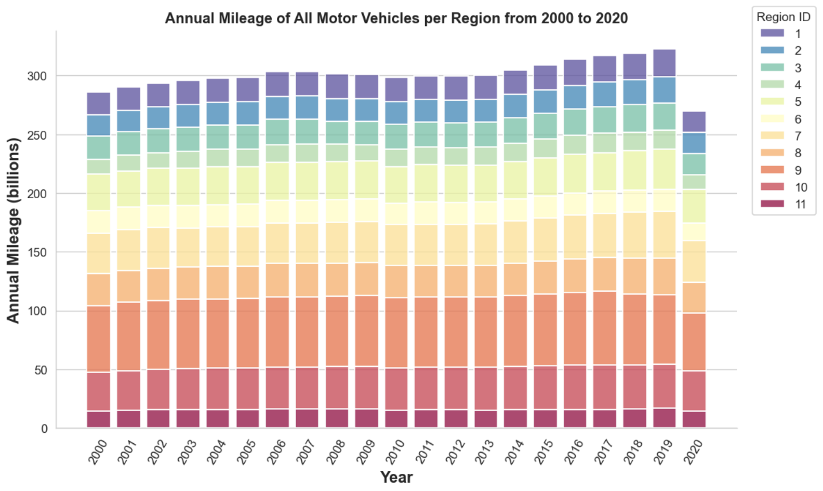
Analysis - Visualising Trends in Data

Slide 8
Analysis - Data Insights
It is evident that annual mileage has gradually increased since 2000 despite the huge fall in 2020. This is predominantly due to UK lockdown measures established to minimise the spread of COVID-19 (Department for Transport, 2020)

Slide 9
Regression
Predicting future Annual Mileage from 2020 to 2050 through a range of regressions:
Least Squares Regression
ARIMA Forecast
Seasonal ARIMA (SARIMA) Forecast

Slide 10
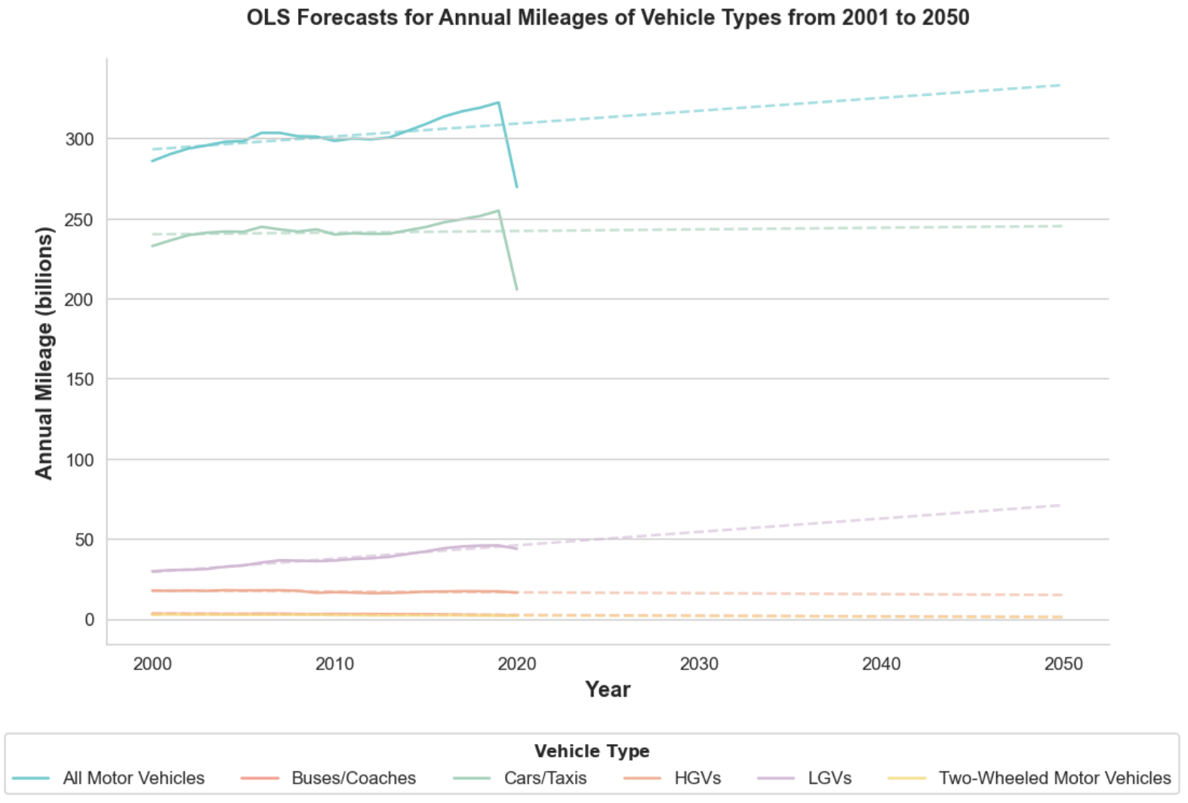
Regression - Least Squares

Slide 11
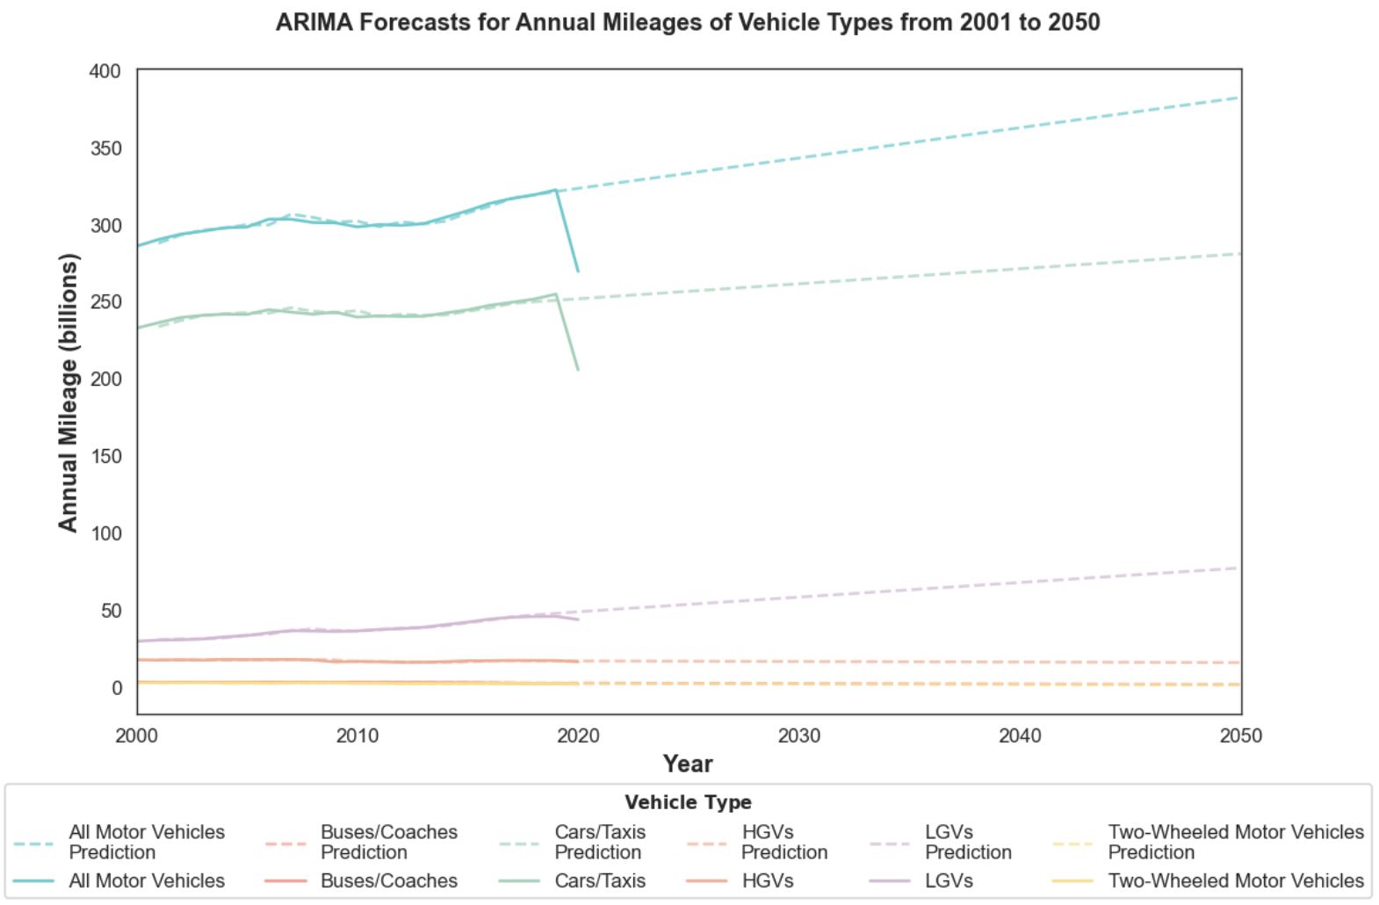
Regression - ARIMA
Parameters P, D and Q chosen by smallest AIC: ARIMA(1, 1, 0)

Slide 12
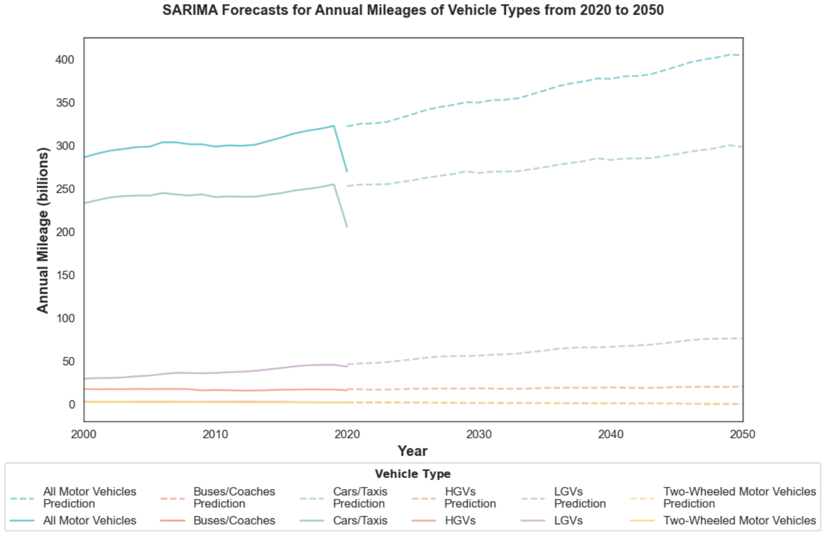
Regression - SARIMA
Parameters same as ARIMA, but with seasonal shift periods of m = 10 to capture repeating trend (seasonality) in data

Slide 13
Regression - Analysis
SARIMA captures and predicts Annual Mileage better than Least Squares and ARIMA
Estimates Annual Mileage to increase to slightly above 400 billion by 2050
Growth in Annual Mileage predominantly due to Cars/Taxis and Light Goods Vehicles
Note that these estimates are limited by a lack of accurate data on minor road AADF and may not reflect true annual mileage due to external factors such as pandemics
It is not currently feasible to track AADF on every individual minor road so estimates have been produced accordingly

Slide 14
Research - Electric Vehicle Adoption
Electric Vehicles are becoming increasingly popular
New Legislation requires that all new vehicles sold beyond 2030 cannot be petrol or diesel forcing shift towards Electric Vehicles
Charging point locations are increasing rapidly to accommodate for increase in Electric Vehicle purchases
The mass adoption of Electric Vehicles will require huge supplies of electricity
The aim is to estimate how many EVs we can expect to see on the roads by 2050 and determine the annual cost of electricity required to run the vehicles
A suitable scheme will be devised to ensure that the increasing demand in electricity is met cost-effectively

Slide 15
Research - Assumptions
Electric Vehicles are assumed to require 0.3 kWh/mile of electricity on average, determined by the statistics of newer models and with the expectation that the efficiency will improve over time
Growth of number of Vehicles on road estimated by a linear regression
Growth of Electric Vehicles on road estimated by a curvilinear regression to account for exponential increase

Slide 16
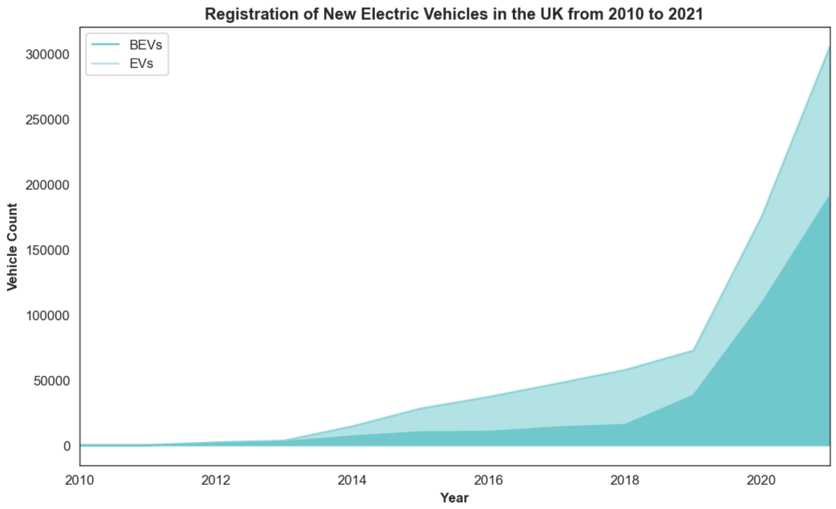
Electric Vehicle Registration Data

Slide 17
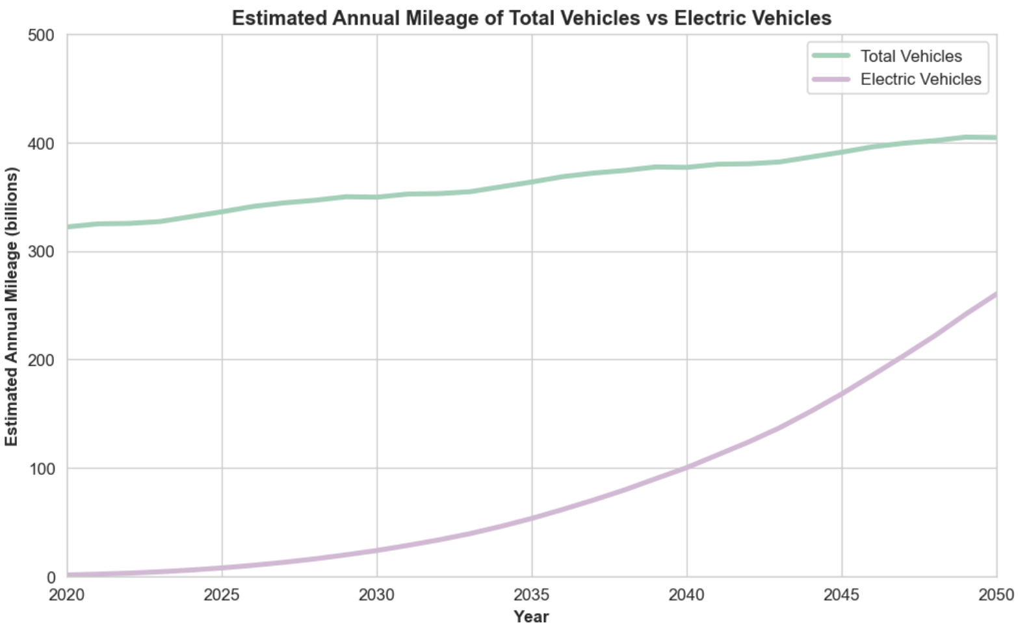
Estimated Annual Mileage of Total Vehicles vs Electric Vehicles
Estimated EV Annual Mileage = Estimated Total Annual Mileage x Estimated EV Percentage Share

Slide 18
Estimating Additional Electricity Consumption
The transition to electric vehicles will increase demand for electricity. In September 2021, Ofgem, the energy regulator, highlighted that electric cars and vans will need between 60-100TWh of electricity annually by 2050 – an increase of 20-30% compared to 2021 levels (Enabling the Transition to Electric Vehicles, 2021)
Electricity Consumption estimated by multiplying expected Annual Mileage with average Electric Vehicles Efficiency (0.3kWh/mile)

Slide 19
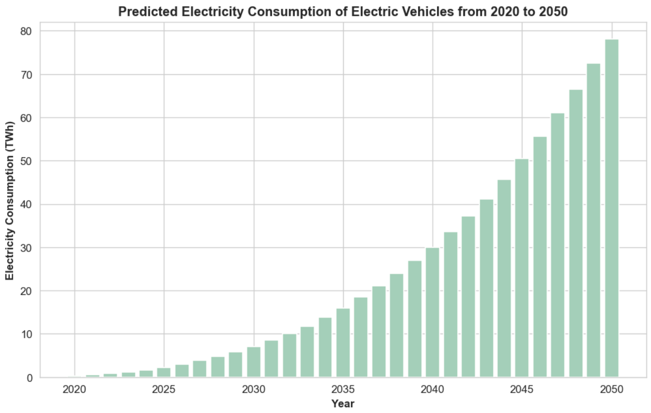
Predicted Electricity Consumption of Electric Vehicles

Slide 20
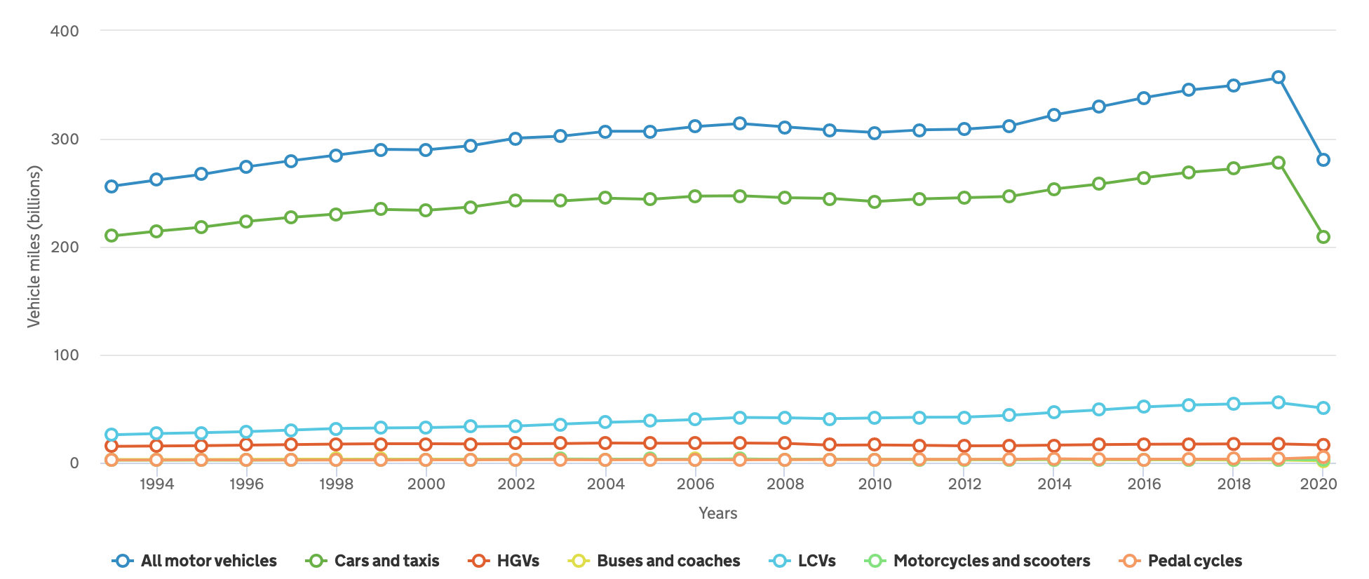
Research Review
Comparing results to published research: Annual Mileages of Vehicles per Type
(GOV.UK, 2020)

Slide 21
Research Review
Comparison shows that plots are very similar and have a similar trend

Slide 22
Research Review
Estimation of an additional 78TWh required to supply Electric Vehicles is inline with online research published by Ofgem, stating that EVs will require approximately 60-100TWh annually by 2050 (Ofgem, 2021)
Based on estimates of Electric Vehicles accounting for roughly 60% of all Vehicles by 2050
Exponential estimated growth of BEVs appear to match predictions of GoCompare, expecting over 3 million BEVs by 2030 (GoCompare, 2021)

Slide 23
Recommendation - Appropriate Generation Technologies
Estimated additional 78 TWh to supply EVs nationwide
78 TWh = 78 000 GWh
Discuss appropriate generation technologies to accommodate for mass adoption of EVs
This will require analysis of factors such as times of day when EVs are charged and its impact on generation technology
Smart Charging and Vehicle-to-grid (V2G) implementation

Slide 24
Recommendation - Appropriate Generation Technologies
Growth in wind power generated by off-shore wind farms will adequately meet the energy demands of mass EV adoption; by 2050, renewable energy will 100TWh of electricity (National Grid, 2020)
The UK currently uses approximately under 300 TWh of electricity annually
Viable renewable energy sources include:
Off-Shore Wind Farms - £47/MWh
On-Shore Wind Farms - £45/MWh
Solar Power Station - £39/MWh
(Edie, 2020)
These prices are not indicative of future prices and may become much cheaper as time passes

Slide 25
Recommendation - Renewable Energy Costs
78 TWh = 78 000 GWh = 78,000,000 MWh
Off-Shore Wind Farms: £47/MWh x 78,000,000 MWh = £3.66 billion
On-Shore Wind Farms: £45/MWh x 78,000,000 MWh = £3.51 billion
Solar Power Station: £39/MWh x 78,000,000 MWh = £3.04 billion
Although Solar is the cheapest, it is limited by its reliance on solar energy and may not be compatible with peak times of EV charging.
Recommend that most of the electricity be generated by off-shore wind farms, in combination with solar power stations and less on-shore wind farms (due to landmass)
Realistically, the above figures are likely to be much less; the figures are an upper bound of what the costs could be

Slide 26
Recommendation - Smart Charging and V2G
Smart Charging and V2G are technologies which will help the national grid cope with the surge in electricity demand from EVs
“Smart use of the electricity system involves using power at times when demand (and therefore prices) is low. Consumers can benefit from cheaper power, and operators benefit from an easier to balance system and avoiding all cars being charged simultaneously” (Pickett et al., 2021, p. 66)
“The concept of ‘Vehicle to Grid’ (V2G), is that when supply is low and demand high, EVs connected to the grid to charge can instead release power back into the grid. Owners of the vehicles can then be paid for this balancing service in a similar way to electricity storage unit operators” (Pickett et al., 2021, p. 66)

Slide 27
Recommendation - Conclusion
From the research I have conducted and the estimates I have produced, I firmly believe that off-shore wind power in conjunction with some solar power stations are the most appropriate and cost-effective generation technology to accommodate for the surge in electricity, demands due to the mass adoption of EVs
I think the UK will be well-equipped to handle an additional 78TWh of annual electricity consumption because the national grid has previously demonstrated being able to generate enough power, and plans to create massive off-shore windfarms will be sufficient for 25 million+ EVs in the future
The adoption of Smart Charging and V2G technology will ease these demands on the grid to ensure these goals are met

Slide 28
References
GOV.UK, 2019. Road Traffic Estimates. [online] Available at: <https://assets.publishing.service.gov.uk/government/uploads/system/uploads/attachment_data/file/524848/annual- methodology-note.pdf> [Accessed 24 April 2022].
Department of Transport. 2020. Road Traffic Statistics. [online] Available at: <https://roadtraffic.dft.gov.uk/summary> [Accessed 24 April 2022].
GoCompare, 2021. The future of electric vehicles: our predictions. [online] Available at: <https://www.gocompare.com/motoring/electric-cars/electric-car-adoption-prediction/> [Accessed 24 April 2022].
National Grid, 2020. Can the grid cope with the extra demand from electric cars?. [online] Available at: <https://www.nationalgrid.com/stories/journey-to-net-zero-stories/can-grid-cope-extra-demand-electric-cars> [Accessed 24 April 2022].
Ofgem. 2021. Enabling the Transition to Electric Vehicles. [online] Available at: <https://www.ofgem.gov.uk/sites/default/files/2021- 09/Enabling%20the%20transition%20to%20electric%20vehicles%20- %20the%20regulators%20priorities%20for%20a%20green%20fair%20future.pdf> [Accessed 24 April 2022].
Pickett, L., Winnett, J., Carver, D. and Bolton, P., 2022. Electric vehicles and infrastructure. [online] Commons Library. Available at: <https://researchbriefings.files.parliament.uk/documents/CBP-7480/CBP-7480.pdf> [Accessed 24 April 2022].

